Slide 1
Project 10 Using a Siamese neural network to find similar faces
Presenters:
יובל ברונשטיין Yuval Brunshtein
אופיר כץ Ofir Katz רון סוקנר Ron Sukner עדן מיירוב Eden Meerov

Slide 2
Motivation for choosing the project
Interest in machine learning
Understanding the process of face recognition using a Siamese network
Working With Image Type Data

Slide 3

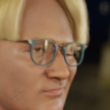
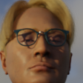

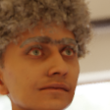
Digi-Face dataset

Slide 4
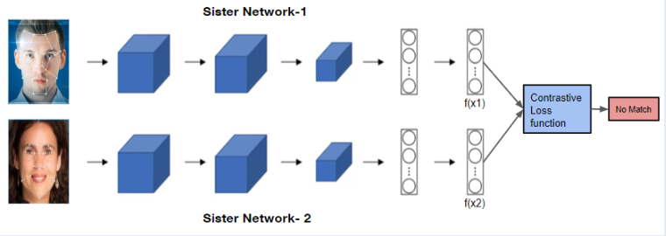
Siamese neural networks for face recognition

Slide 5
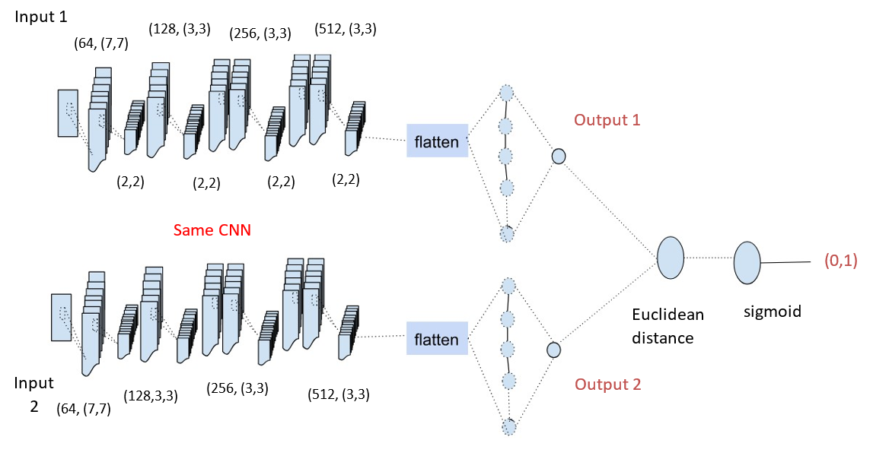
architecture

Slide 6
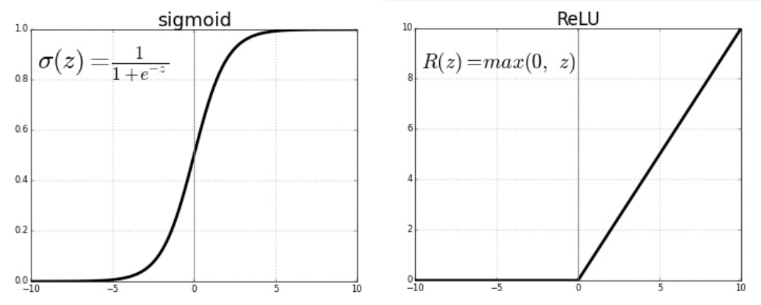
Operation function
Functions we used:
Rectified Linear Units(ReLU)
SIGMOID

Slide 7
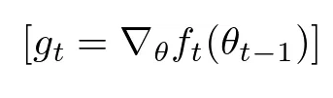
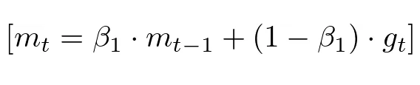

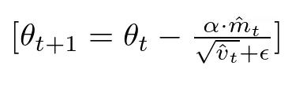


Optimization algorithm
Adam

Slide 8

Loss function
Binary Cross Entropy

Slide 9
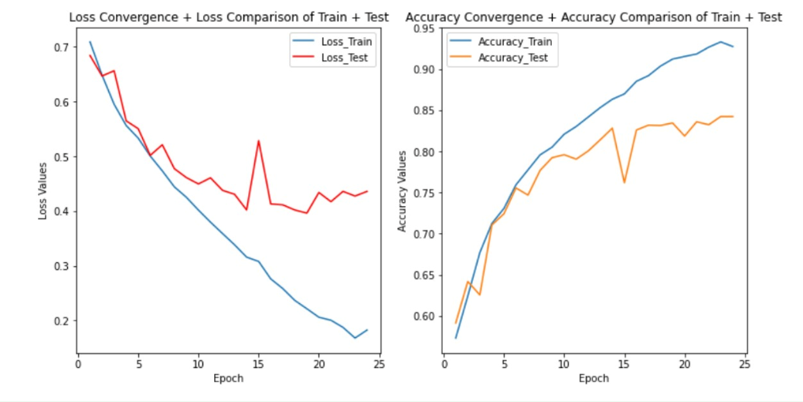
Model performance
Validation Data VS Training Data

Slide 10
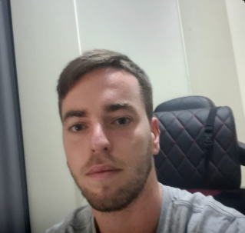
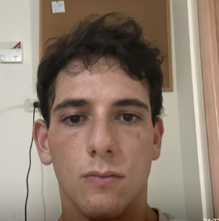



ron vs Yuval ordinary example

Slide 11
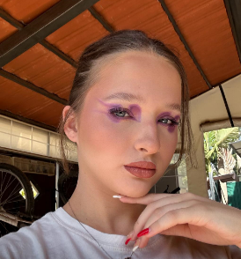
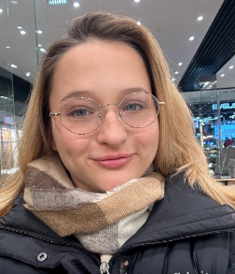


Yuval’s wife extreme example

Slide 12
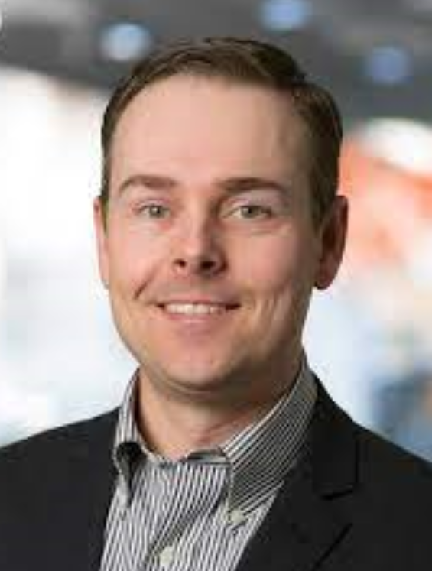
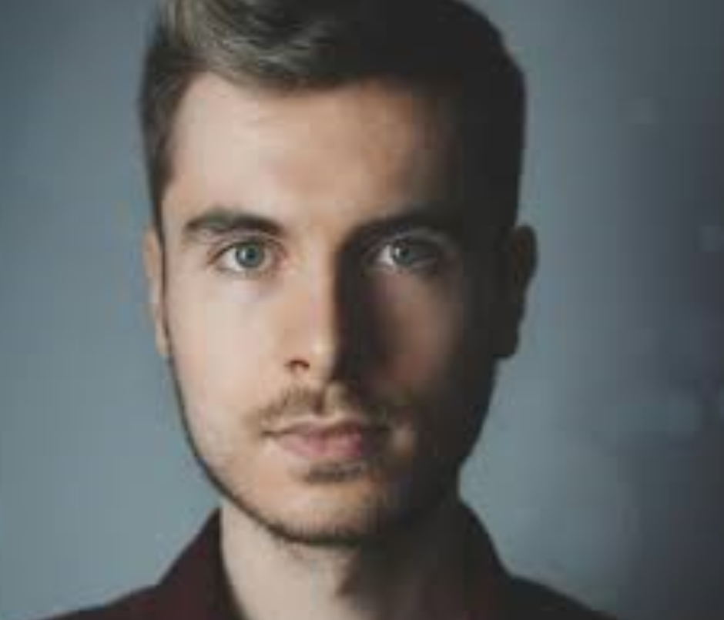


Model inaccuracy example

Slide 13
References:
https://openaccess.thecvf.com/content/WACV2023/papers/Bae_DigiFace-1M_1_Million_Digital_Face_Images_for_Face_Recognition_WACV_2023_paper.pdf - DigiFace 1 Million Digital Face Images For Face Recognition
https://towardsdatascience.com/understanding-binary-cross-entropy-log-loss-a-visual-explanation-a3ac6025181a -Binary croosentropy
https://towardsdatascience.com/the-math-behind-adam-optimizer-c41407efe59b - Adam Optimizer

Slide 14
EXTRA INFORMATION ABOUT THE PROJECT
Libraries
Code Architecture
Data Processing

Slide 15
Python Libraries
Numpy
TensorFlow
Keras
Cv2
Os
Pandas
Matplotlib

Slide 16
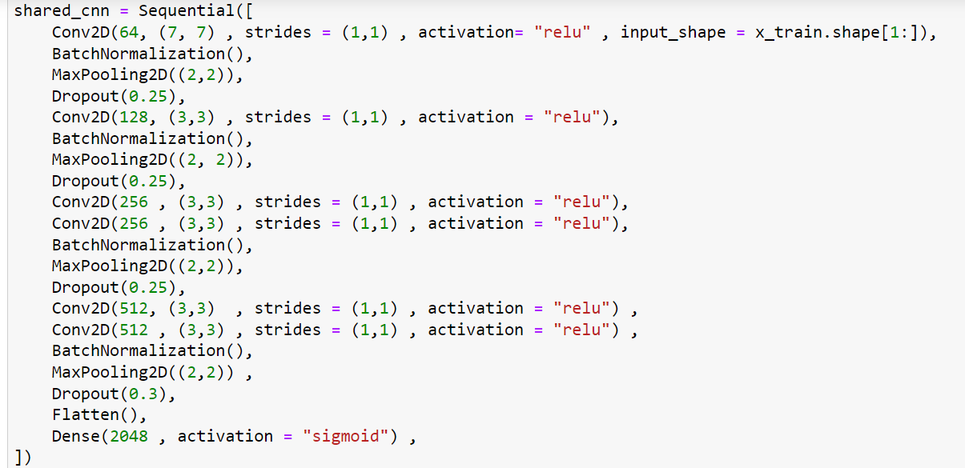
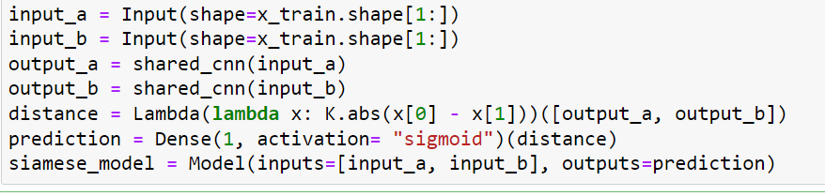
Architecture code

Slide 17
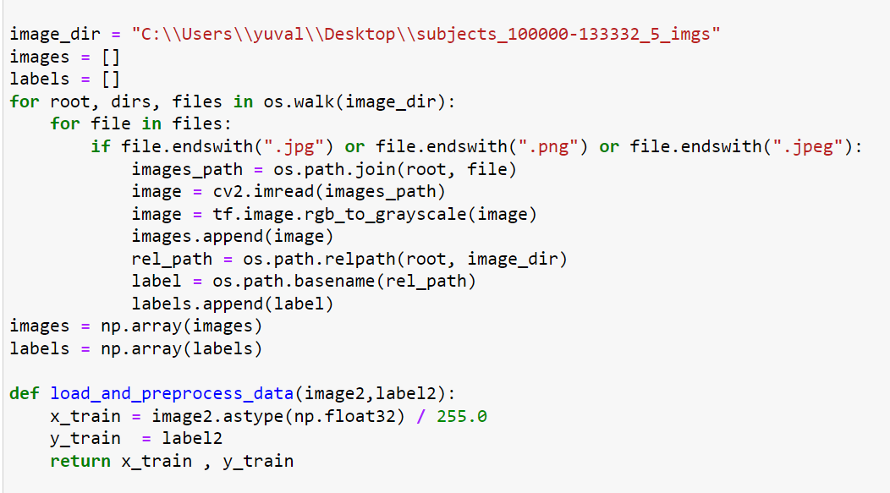
Data processing

